Slide 1


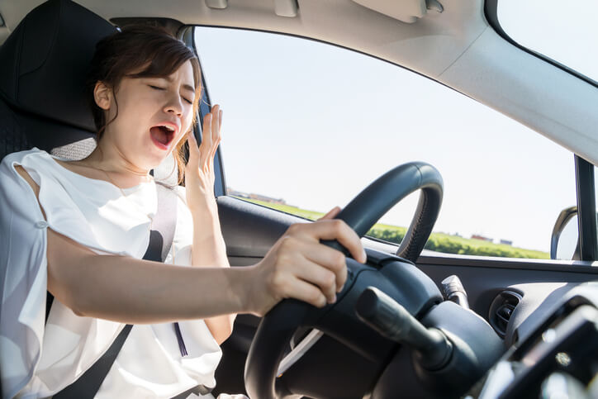
RAJ KUMAR GOEL INSTITUTE OF TECHNOLOGY GHAZIABAD
DEPARTMENT OF COMPUTER SCIENCE & ENGINEERING
SESSION:-2020-2021
DRIVER DROWSINESS DETECTION
SUBMITTED BY:-G-8
1.PRINCY UPADHYAY(1703310139)
2.LAUREN JAIN(1703310102)
3.SATYA MISHRA(1703310176))
4.SHRIYA GOYAL(1703310195)
GUIDE : DR. SACHI GUPTA(HOD CSE)

Slide 2
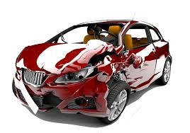
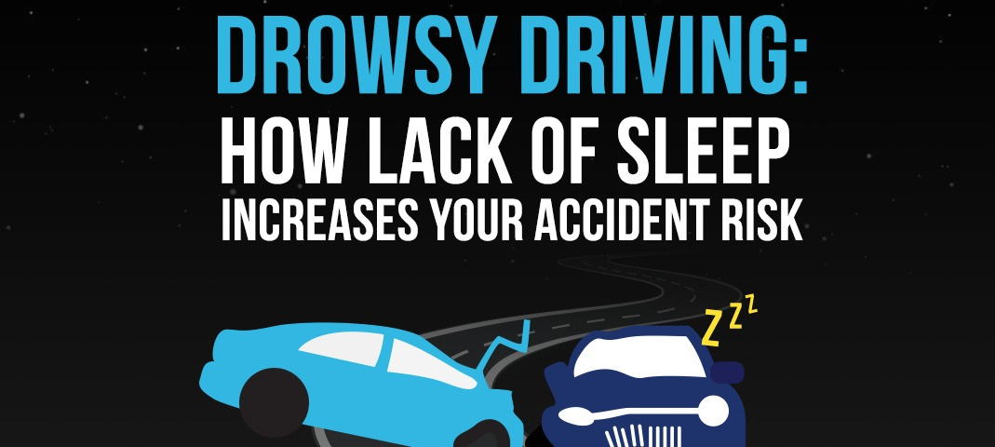
ABSTRACT
According to National Crime Records Bureau(NCRB) over 1,48,707 people were killed in road accidents.
Two wheelers account for 25% of total road crash deaths.
There is one death in every 4 minutes due to a road accident in India.
India ranks 1st in the number of road accidents.
According to NSF about 37% or 103 million people have fallen asleep at the wheel.

Slide 3
LITERATURE SURVEY
Technique 1-Vehicle Based Measures:-These measurements are determined in a simulated environment by placing sensors on various vehicle components, such as the steering wheel and the acceleration pedal.[1]
Technique 2-Physiological Measures:-The correlation between physiological signals electrocardiogram (ECG), Electromyogram (EMG), Electrooculogram(EoG) and electroencephalogram (EEG)) and driver drowsiness has been studied by many researchers.[2]
Technique 3-Subjective Measures :-Subjective measures are those which evaluate the level of drowsiness based on the driver’s personal estimation.[3]
Technique 4-Behavioral Measures :-The behaviour of the driver, including yawning, eye closure, eye blinking, head pose, etc. is monitored through a camera and the driver gets alert if any of these drowsiness symptoms are detected.[4]

Slide 4
COMPARISON OF DIFFERENT MEASURES
MEASURES | PARAMETER | ADVANTAGES | DISADVANTAGES
Physiological Measures | Information derived from the physiological Sensors | Reliable , Accurate | Intrusive
Subjective Measures | Questionnaire | Subjective | Unrealistic
Vehicle-based measures | Steering wheel Movement , Standard Lane deviation | Non-intrusive | Unreliable
Behavioral measures | Eye closure, yawn | Non-intrusive , Ease of Use | Lighting condition Background

Slide 5
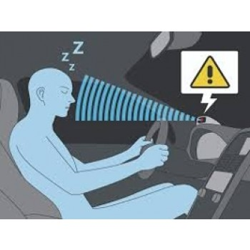
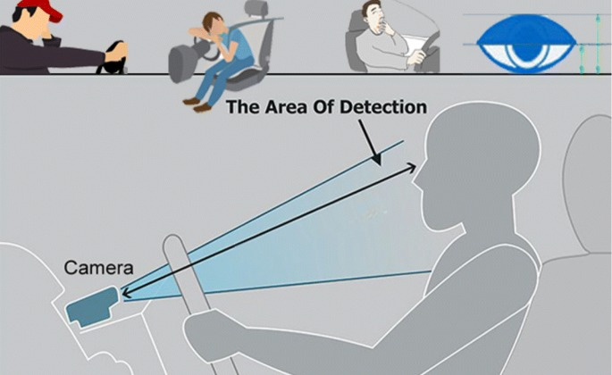
PROBLEM STATEMENT
Design a prototype of Driver Drowsiness Detection System using Computer vision.

Slide 6


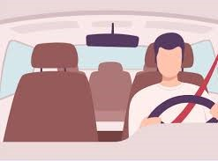
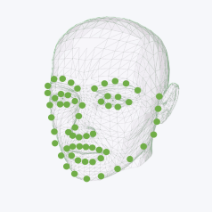

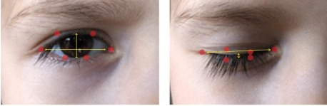
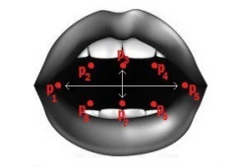
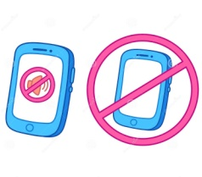

SOLUTION APPROACH / METHODOLOGY
System
Webcam
Video Capturing
Dividing Video into Frames
Send Location of Driver
Facial Landmarks Extraction
Near ones of Driver
Is it a drowsy state?
Eye Closure Detection
Yawn Detection
Yes
Alarm turnoff by Driver Manually
Warning Alarm
No

Slide 7
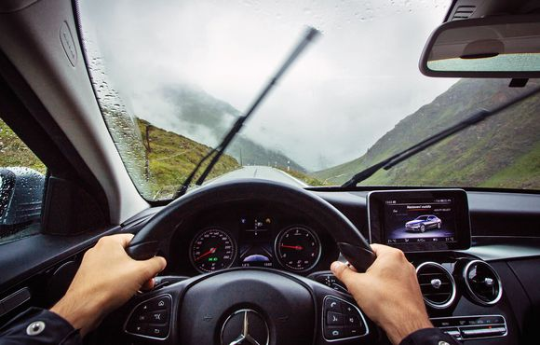
PROTOTYPE OF DRIVER DROWSINESS DETECTION SYSTEM
DRIVER DROWSINESS DETECTION
START
SHARE LOCATION
ADD CONTACTS
ALARM PLAYLIST

Slide 8
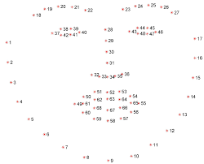
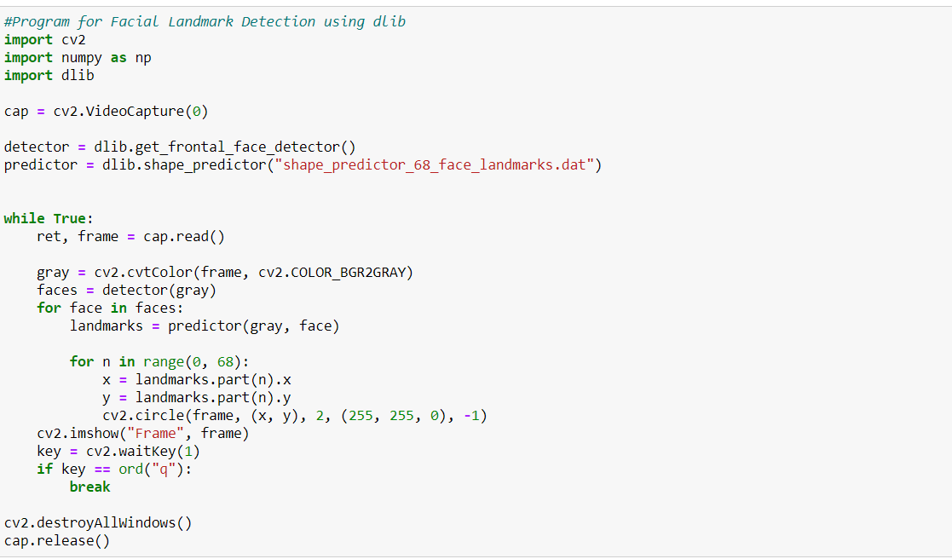
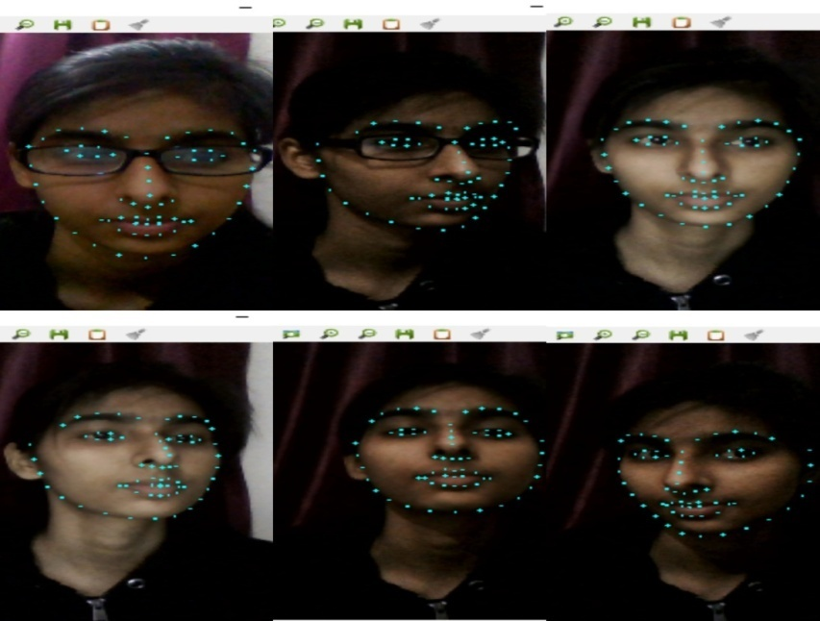
IMPLEMENTATION
Detection of facial landmark of driver in real time using OpenCV, dlib library.
The pre-trained facial landmark detector inside the dlib library is used to estimate the location of 68 (x, y)-coordinates that map to facial structures on the face.
Facial landmarks are used to localize and represent salient regions of the face, such as:
Eyes
Eyebrows
Nose
Mouth
Jawline
OUTPUT

Slide 9
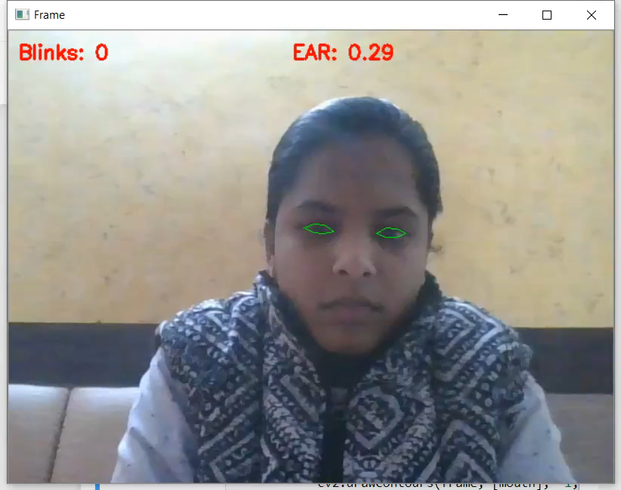
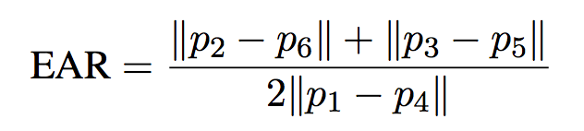
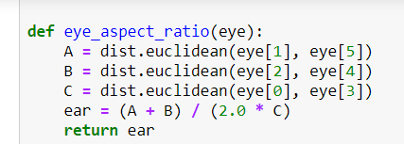
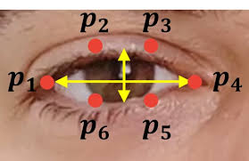
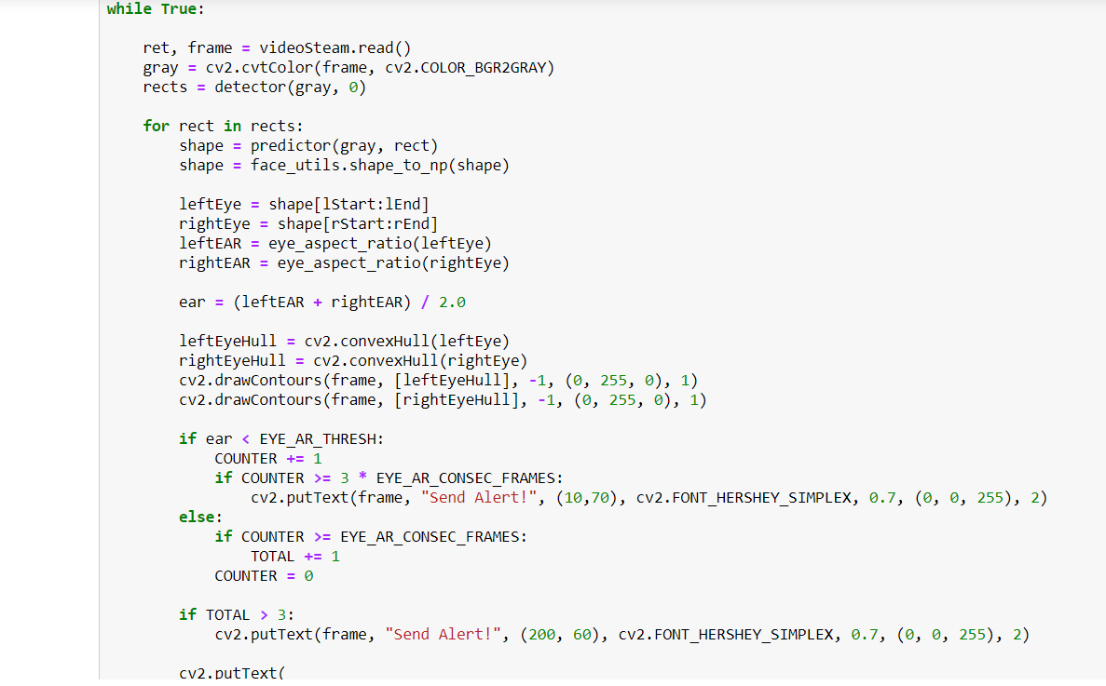
IMPLEMENTATION
Detection of eye blinking of the driver in real time using OpenCV and dlib.
Following are the steps for implementation of eye blinking :-
Eye localization.
Calculation of Eye Aspect Ratio.
Check condition - If EAR value is less than 0.28 in 30 frames then eye blink is detected and after 3 blinks, a warning is generated.
Or if EAR value is less than 0.28 in 90 frames then also a warning is generated.
OUTPUT

Slide 10
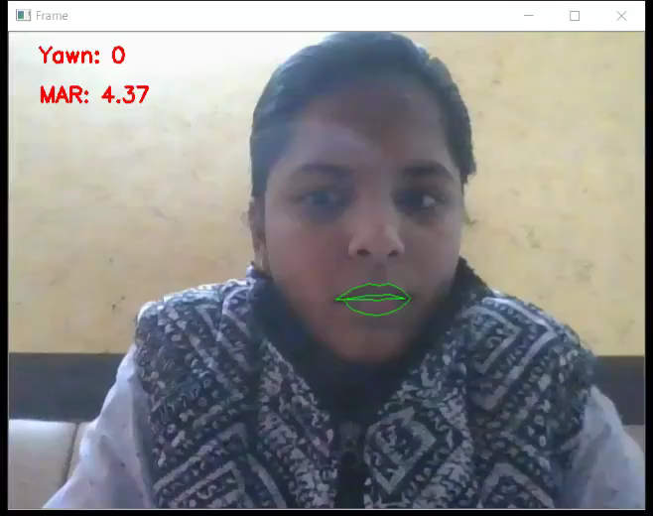
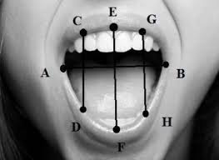
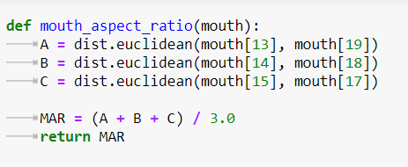
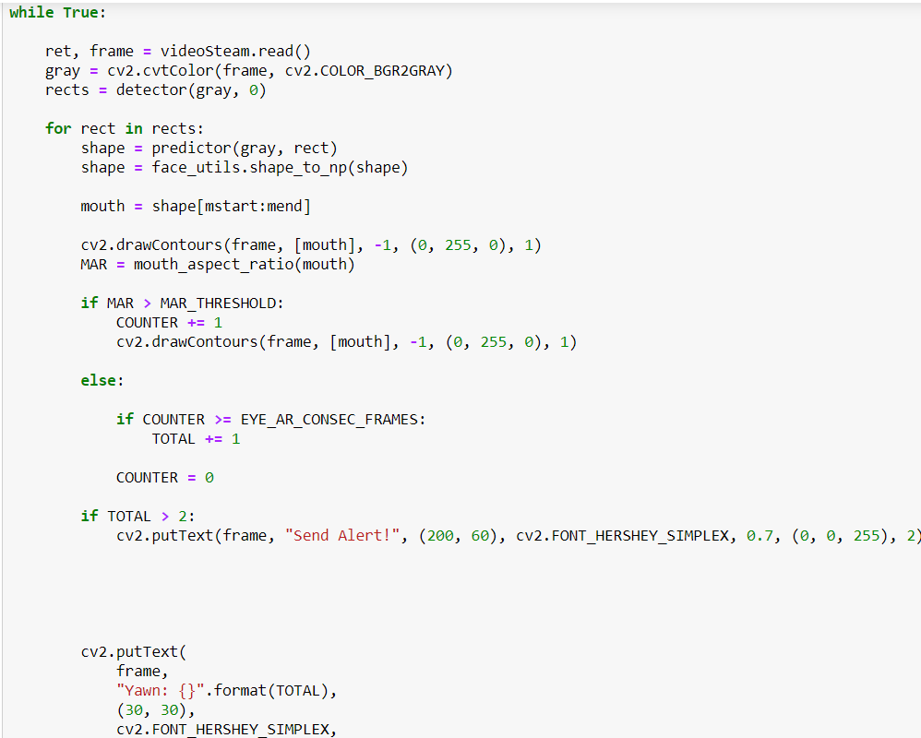
IMPLEMENTATION
Yawn Detection of driver in real time using OpenCV and dlib.
Following are the steps for implementation of yawn detection:-
Mouth localization.
Calculation of Mouth Aspect Ratio.
MAR=||C-D||+||E-F||+G-H||
3.0
Check condition - If MAR value is greater than 14 in 30 frames then yawn detected.
OUTPUT

Slide 11
STATUS OF RESEARCH PAPER
A review paper(Driver Drowsiness Detection) has already been drafted and will be sent to the reputed journal/conference.
The implementation of project is in progress, so in the month of February one more computation based research paper will be submitted to the reputed journal/conference.

Slide 12
WORK PLAN FOR NEXT ONE MONTH
Integrate EAR and MAR calculations with some conditions of drowsiness.
Design a frontend for Driver drowsiness detection system.

Slide 13
REFERENCES
[1]. JarekKrajewski, David Sommer, UdoTrutschel, Dave Edwards, Martin Golz. Steering Wheel Behavior Based Estimation of Fatigue. June,2009;
https://ir.uiowa.edu/cgi/viewcontent.cgi?article=1311&context=drivingassessment
[2]. Zahra Mardi, Seyedeh Naghmeh Miri Ashtiani, Mohammad Mikaili. EEG-based Drowsiness Detection for Safe Driving Using Chaotic Features and Statistical Tests, Zahra Mardi. May-Aug, 2011;
https://www.ncbi.nlm.nih.gov/pmc/articles/PMC3342623/
[3]. Alina Mashko. Subjective Methods For Assessment Of Driver Drowsiness. December, 2017.
https://www.researchgate.net/publication/322205318_SUBJECTIVE_METHODS_FOR_ASSESSMENT_OF_DRIVER_DROWSINESS
[4]. SayaniGhosh, T. Nandy, Nilotpal Manna. Real Time Eye Detection and Tracking Method for Driver Assistance System. 2015;
https://www.semanticscholar.org/paper/Real-Time-Eye-Detection-and-Tracking-Method-for-Ghosh-Nandy/6d4407b102766cef693c873f4ce37bb19b58bb8c

Slide 14
THANK YOU

